Slide 1
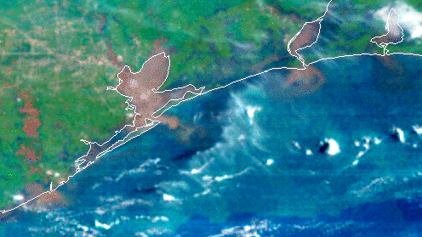
BREAK
RESUMING AT 115 PM EDT

Slide 2


User Engagement
Roadmap
FY 26-28
FY 28+
Finalize User Needs Assessments
User Readiness Activities
Product/Infrastructure/Process Readiness Development
Follow-on workshops
Finalize User Readiness
Organizational Readiness
Pathfinders
Training
Through FY 2025
GeoXO road shows and Symposiums
Support the User Scientists in their respective UE events and track progress
Identify prospective Pathfinders
Build contact database and stakeholder
relationships for future user readiness
campaigns
Notes:
The fourth stage in our process is developing user engagement milestones
These milestones are tied directly to the our stakeholder needs
This is not a complete list but I would like to highlight a few new user engagement activities we are doing this year
Also why these are very important

Slide 3

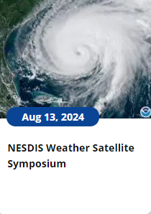
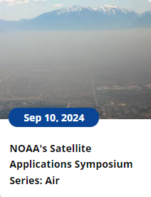
User Engagement Updates
Themed Symposium Series Repeating Every ~6 Months Through 2025
  Human Health/Air Quality OCTOBER
  Fire TBD
Road Shows Every ~6 Months through 2025
  South Florida July 16-18
  SoutheastLouisiana (New Orleans Based) January
  San Diego or NW area (possibly August 2025)
User Scientist Related Events/User Readiness Workshops FY2026 and Beyond
Brief Program Updates, Quarterly
Newsletters, Semi-Annual
Based on Your Feedback, We Know When YOU Want to be Involved!

Slide 4
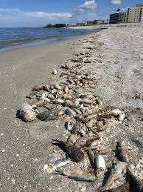
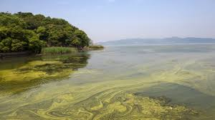
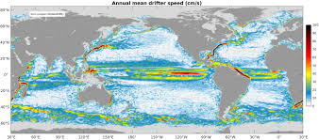
Stakeholder Session
The Key to the Future of Operational Ocean Color Data
Quick Poll
Brainstorming with Our Users
Your Input Is VITAL for Us to Be Able to Help You!

Slide 5
Stakeholder Session
Who are you monitoring Ocean Color for? And how do you interact with end-users?

Slide 6
Stakeholder Session
Where/how have you struggled with using or interpreting ocean color data?

Slide 7
Stakeholder Session
What sort of value-added service would help you interact with satellite data more?

Slide 8
Stakeholder Session
Is there a limiting factor keeping you from using satellite data to make a decision? What is it?

Slide 9
Stakeholder Session
If you use satellite data to inform decisions, what do you need to make your current or future operational decisions using ocean color more effective?
  More Training?
  Accessible Products?
  Certain Levels of Accuracy?
  Different products?

Slide 10
Stakeholder Session
Anticipate a make-over of the data delivery system (think weather service as an example). What would make this data easier to use for you to interact with?

Slide 11
Stakeholder Session
With improved capabilities in GeoXO how would you change monitoring and preparations?
  Subdaily versus 2x a week?
  How would quicker information save you and the economy money?
  More information in bays and estuaries?
  Better characterization of the water (HABs, plumes, runoff, oil, etc.)

Slide 12
Stakeholder Session
If you don’t use ocean color data, why not?

Slide 13
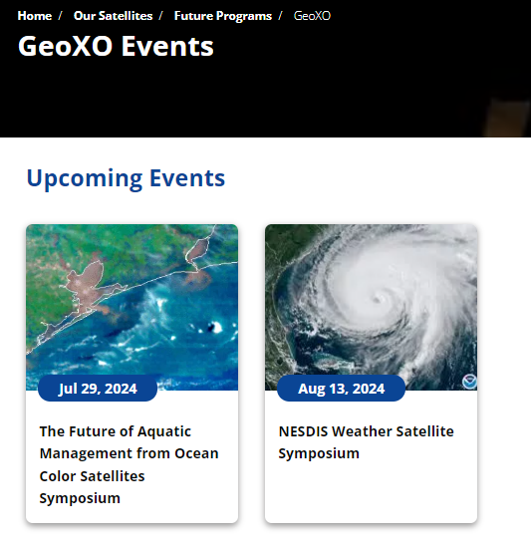

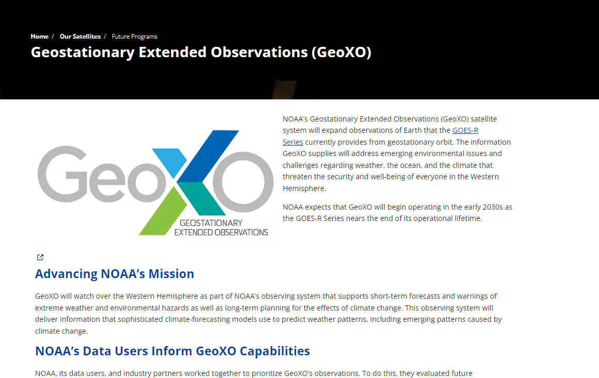
User Engagement Updates
Events Webpage:
Feedback Form:
GeoXO Webpage:
A copy of all slides will be emailed by PDF to attendees tomorrow
GeoXO.Satellites@NOAA.gov

Slide 14
BREAK
RESUMING AT 300 PM EDT

Slide 15
Thank You!!
Slides Will Be Available on the GeoXO Event Webpage Soon!

