Slide 1
Role of social science research and user engagement practices for enhancing the impact of oceanographic science
Yusuke Kuwayama
University of Maryland, Baltimore County
July 29, 2024
NOAA SATELLITE APPLICATIONS SYMPOSIUM SERIES

Slide 2
The VALUABLES Consortium
A cooperative agreement between RFF and NASA to measure and communicate how satellite information benefits people and the environment when we use it to make decisions
Large, sustained effort to measure the socioeconomic benefits of Earth observations
Goes beyond anecdotes to quantify these benefits, often in dollar terms
Focuses on things that are beneficial to society, like lives saved and increases in profits and crop yields

Slide 3
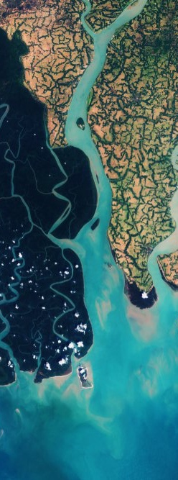
What We Do
VALUABLES focuses on two types of activities:
Conducting impact assessments
  Building the impact assessment literature on Earth observations for decisionmaking
  Applying existing methods and using new methods
Developing educational materials and activities to build capacity within the Earth science community to quantify the value of its work. This includes:
  Improving understanding of impact assessment terms, concepts, and methods
  Developing a value of information (VOI) framework the community can use to design rigorous impact assessments
  Using this framework as the basis for tutorials, webinars, and workshops
Notes:
​​​

Slide 4
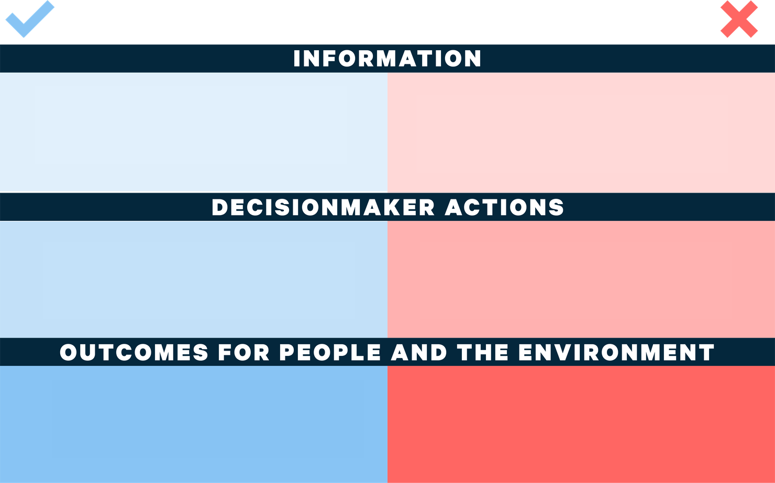

Slide 5

The “Value of Science” Explainer Series
Introduces key terms, concepts, and methods that scientists and managers can use to measure the socioeconomic benefits of their own work:
101: What is “Value”?
102: Measuring the Value of Scientific Research Using Economics
103: Categorizing the Socioeconomic Benefits of Scientific Information, Part 1
104: Categorizing the Socioeconomic Benefits of Scientific Information, Part 2
105: Three Principles of the Value of Information
106: The VALUABLES Impact Assessment Framework
107-109: The VALUABLES Impact Assessment Framework
  Step 1: Identifying Improved Information and Its Alternatives
  Step 2: Identifying How New Information Influences Decisions
  Step 3: Identifying How Decisions Influence Outcomes for People and the Environment
201: Monetizing the Value of Information
202: Quantitative Methods for Impact Assessments
203: The Value of Scientific Information When Future Outcomes Are Uncertain
Available at https://www.rff.org/valuables/tools-resources/

Slide 6
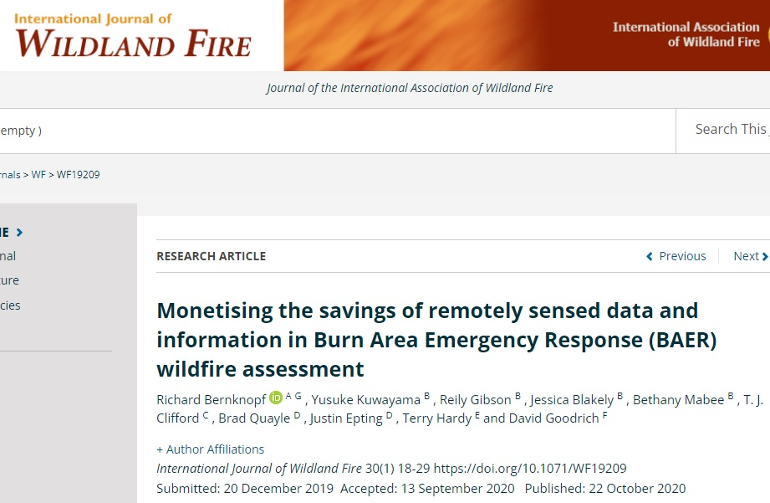
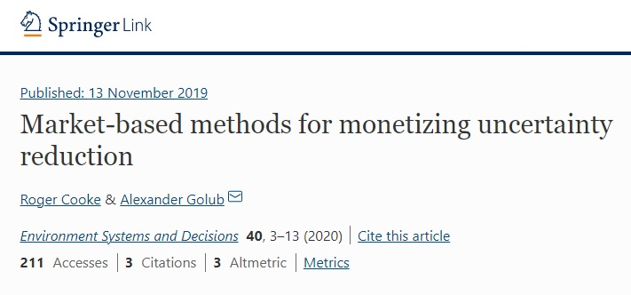
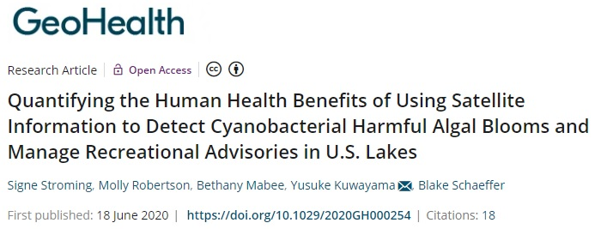
Impact assessments

Slide 7
Impact assessments – Working papers

Slide 8
How can economics enhance the impact of oceanographic science?
Theories and hypotheses about how humans and the environment interact
  Focus on incentives, tradeoffs, and constraints
  Can be expressed as mathematical models and integrated with natural/physical science models
Data-driven policy evaluation
  Sensitive to challenges associated with data from human systems

Slide 9
How can economics enhance the impact of oceanographic science? (continued)
Informing policy design
  Can be based on theoretical or empirical evidence
Nonmarket valuation
  For cost-benefit analysis
  For estimating the socioeconomic benefits of scientific information

Slide 10
Some thoughts on social science integration
Social scientists have their own definitions of what is innovative in science.
  Truly integrated projects need to include activities that social scientists deem to be novel and transformative.
  Social science is not just a tool to make natural/physical science more societally relevant.
Implication: Social scientists need to be
  Involved in the early planning stages;
  Involved in project leadership;
  Provided with the same research resources as natural/physical scientists.

Slide 11
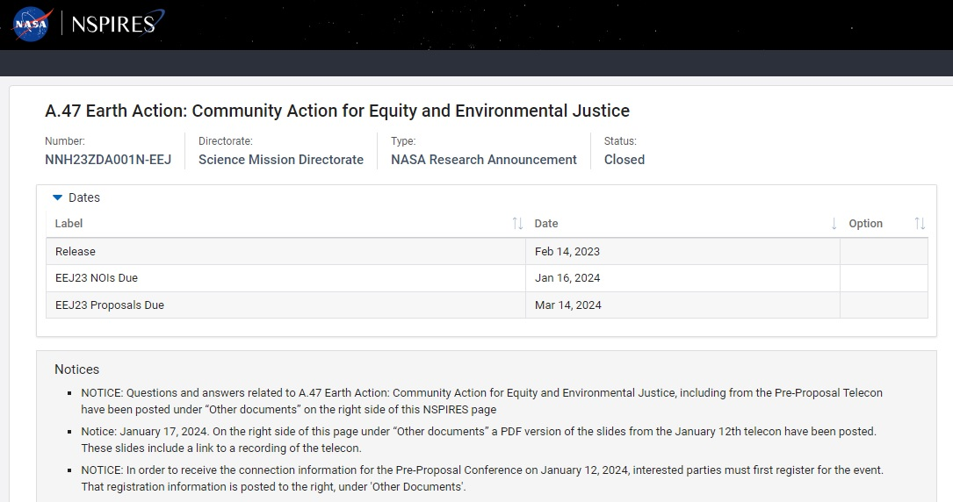
Some thoughts on community engagement
Social scientists can help build bridges between natural/physical scientists and communities…
  Based on their knowledge of social processes and policy contexts
  Based on their connections to community leaders
…but successful work with communities requires:
  A community engagement expert (not just a social scientist)
  Direct involvement of community representatives

